Slide 1
Workbook Synergy Management
TrAction Tool
Internal Use Only
April 2017
EXCEL FILE:

Slide 2
Disclaimer
The content of this workbook has been produced by KPMG Germany/Deal Advisory on the basis of German accounting standards and/or IFRS, as well as considering KPMG Germany’s firm and country requirements, regulations, processes, policies and best practices. Please check your local accounting and other requirements before applying the content.

Slide 3
Overview (1/4) – Mission statement
Flag: TrAction is a global project management tool. For the distribution in your region please refer to following link: https://www.kpmgspectrum.com/content/Spectrum/en/Operating-Intelligence/TrAction.html
Synergy Management
Mission Statement:
Determine, evaluate and ensure achievement of the target sales and cost synergies related to a transaction and avoid any dissynergies
Customer situation
Definition/Methodology/Tools of the basis analysis
Buy Side/JV
Buy side: Critical success factor for the determination of an appropriate purchase price and its amortization in connection with the sustainable realization of the value-increasing integration strategy
JV: Co-determination/Governance hinders the definition of the synergy targets
For synergies between individual business units of a company portfolio see ”Strategic Portfolio Review“ workbook (available in DA Germany)
Definition
Synergy management on the buy side covers the entire transaction process: from the strategy phase (high level synergies in the framework of the deal rationale/target search) through the Due Diligence (identification and assessment), through the signing to the closing (validation, detailing and gap analysis) as well as post-deal implementation and monitoring after closing
Methodology
Strategy/Target Search
In the search for a suitable target high-level synergy considerations are involved, e.g. regarding overlaps in regions, products, customers, etc. (strategic fit). This may occur in the framework of a commercial DD (see workbooks Market Analysis, Customers, Competition)
Synergy assessment
Synergy due diligence (operational due diligence) includes the following assessments:
Transparency about cost structure, critical appraisal of the revenue forecast, identification of the value drivers along the value chain
Assessment/Determination of the NPV of the synergies
Post-DD: Review and ”outside-in“ further development of the DD findings and/or validation of the DD-findings on the customer side (depending on the time of entry into the project)
Synergy case (depending on the information circumstances/access the case occurs between the signing and closing or after the closing): In cooperation with sales, controlling and planning of buyer and target, the information from the synergy assessment is updated and linked with the operating planning of the buyer and the target
Benefit tracking/Monitoring (after closing): Establishment of a sustainable project structure including suitable tools and processes for sustaining the progress and successful implementation
Resources and cost management
TrAction Tool
Degree of standardization
The methodology is standardized in its approach and deliverables: Quantification in Excel, output presentation in PowerPoint, monitoring and benefit tracking in “TrAction Tool“

Slide 4
Overview (2/4) – Pitfalls
Synergy Management
No. | Pitfalls/Lessons learned
 | For an efficient synergy assessment in the framework of a DD, the essential information must be quickly derived from the mass of information. Do not get lost in details – the starting points for optimization potentials are for instance COGS and SG&A costs. Quantifications at this point in time are high-level/ 80/20 outside-in view Concentrate on the key issues for the validation of the existing optimization programs/planning. How large is the gap to the competitors? What are the risks? In growth cases it must, for instance, be checked if the existing infrastructure and management are able to make the growth case possible. Here, too, the work should not be too detailed, concentrate instead on 3-5 key issues
 | Were the right subject matter experts/specialists included in the identification and quantification of the synergy potentials? In case of sales synergies from new or combined products: Has the assumed market demand been validated? Have all the important fields of synergy been considered?
 | Review: How was the EBIT effectiveness of the sales synergies determined? Frequently, in-deal only a rough estimation (e.g. 8% of net sales) is performed (check if the quantification is realistic). A separate determination of the P&L effectiveness of the individual synergy goals is performed in the framework of a comprehensive synergy case
 | Have the dissynergies and implementation costs been considered, e.g. R&D expenses for new/combined products, costs of rebranding measures, trainings for sales staff, etc.?
 | To compare the updated forecasts from the gap analysis to the synergy goals, the responsible persons from R&D, Sales and Finance (buyer and target) should be included in workshops to derive realistic sales forecasts
 | It is necessary to find a reporting schedule for the implementation: The intervals may not be too long so as to keep the pressure on the project. Intervals that are too short, however, are unrealistic for synergies involving new products or new customers. In addition they generate high expenditure for administration/reporting
1
2
3
4
5
6

Slide 5
Overview (3/4) – Core issues
Synergy Management
Core Issue | Specific analysis | Page(s)
What role do synergies play in the transaction management? | Synergies have an impact on value and therefore on the determination of the purchase price Overview of types of synergies | 6-8
2. What synergy potentials can be determined? | Generate transparency of selected drivers of profitability, cost and liquidity Comparator analyses with competitor data Separate top-line validation Validation of existing initiatives / optimization programs at the target | 9-10
How are the synergy potentials assessed? | Cash flow model for synergies and dissynergies WACC with risk premium adjusted to synergies/dissynergies Benchmarking of the synergies with comparable transactions: NPV Opex and capex run-rates Ramp-ups of synergies on the timeline Comparison of the profitability of the merged/integrated units with peers (size, position in the market, etc.) | 11-18
Synergy assessment and synergy case: What financial goals must be achieved overall? | Linking of the standalone case with the synergy targets (sales and costs synergies) on Sales, EBIT and Cash level | 19
Synergy Case: What additional costs (or optimization potential) occur with the implementation? | Interviews with responsible people from sales, R&D, production, finance | 20
Synergy Case: Gap analysis - Can the goals be achieved according to the forecast? | Gap analysis of the originally established synergy targets with the actual forecast per synergy | 21
How can an effective monitoring be guaranteed? | Clear definition of responsibilities for the implementation and monitoring of the individual measures Monitoring of the implementation with suitable tools (TrAction) | 22-26

Slide 6
Overview (4/4) – Approach
Synergy Management
1
2
3
Synergy assessment (before closing)
Synergy case (after signing)
Implementation/Monitoring (Preparation after signing, execution after closing)
Approach:
Project entry before the due diligence or in the DD - often in the framework of an operational due diligence
Generate transparency about one-off-costs and ongoing P&L-effects, especially COGS and SG&A
Comparator analyses with competitors’ data
Separate top-line validation
Assessment of the synergy potential
Project entry after DD, but prior to signing:
“Outside in“ review of the information on the customer side e.g. findings from the due diligence; previously formulated financial targets, e.g. from management board documents, investment proposals, M&A business cases, etc.
Workshops with experts on the buyer side, who were involved in compiling the information listed above (e.g. from sales/R&D/production or from M&A/Finance) for validation and updates of the data
Linking of the synergy goals with a standalone planning of the target (if planning data available) for high-level “Joint Business Case“
This high-level „Joint Business Case“ is considered in the integration (JV) blueprint and is approved by the steering committee
Output:
High level “Joint Business Case“ in Excel
Management presentation of the core statements in PowerPoint
Approach:
After signing and beyond closing
As soon as the access to the target allows an exchange of sensitive information (e.g. data on products and prices, R&D, sales, customers), sales and cost synergies will be compiled in individual synergies (for instance at the level of product groups, new distribution campaigns, etc.)
Workshops for each synergy with representatives from the affected functions, especially sales, R&D, production for the detailed determination and forecast of the sales synergies as well as for the identification of additional synergy potentials
If possible: workshops with the CFO (or Finance staff) of the target for a detailed determination and forecast of cost synergies as well as for the identification of additional synergy potentials
Cooperation with Controlling / planning of buyer and target for the determination of the P&L effectiveness of each synergy and the implementation of the goals in the mid and long-term company planning
Output:
Synergy case at the individual synergy level incl. EBIT/EBITDA effectiveness, one-offs, capex, FTE impacts, etc.
Gap analysis between the original synergy goals from the due diligence / M&A business case and an adjusted forecast at the level of the individual synergies
Approach:
Establish a project structure for the monitoring of the implementation progress
Regular workshops with clear responsibilities for each synergy
Reporting to the integration (JV) management
Tracking of the measures with TrAction
Output:
Transparency about the progress of the synergy realization
Early warning system in case of deviation from plan
Clear responsibilities and reporting structures

Slide 7
1. What role do synergies play in the management of transactions? (1/3)
Synergy Management
Core statements:
Both repeating and one-off synergies must be considered in a transaction
(Operating) synergies may be sales or cost driven
Dissynergies are core risks of every transaction and must be anticipated and steered in advance of any transaction
Typical one-off costs are costs caused by the integration or by actual and opportunity cost of personnel (management resources) assigned to the project
New markets/ new products / segments
Customer penetration
Cross-selling
Brand leverage
Relationship risk
Dual sourcing risk
Diseconomies of scale
Product cannibalization
Disposal of assets
Changes in trading terms
Capex to support revenue synergies
Dis-synergies
One-off costs
Working capital and fixed asset synergies
Working capital and fixed asset investments
Revenue synergies
Value upside potential
Eliminate duplication
Leverage economies of scale
Areas of opportunities span the entire business, e.g.:
Supply chain, distribution, procurement
Manufacturing and R&D
General & admin
Property & IT
People
Corporate functions
TSA savings
Integration costs (e.g. redundancies, closure costs, IT integration)
Project management
Execution contingency
Cost synergies
recurring
Stand alone value (incl. TSAs)
Value to acquirer
Assessed on EBITDA basis
Assessed on cash basis

Slide 8
1. What role do synergies play in the management of transactions? (2/3)
Synergy Management
Core statements:
The NPV of the future synergy effects must be higher than the price surcharge paid
The danger of miscalculating synergies/dissynergies threatens the actual increase in value
Companies tend to underestimate the acquisition and integration costs
€m
Potential value
Initial situation
Potential value created
6
Risks of new strategies
5
Value creation
Current market price
How can price and value be compared?
4
Risks of synergies
2
3
1
Dissynergies
Growth oppor- tunities
Growth oppor- tunities
Risks of acquisition
Value destruction
Assets in place
Assets in place
Risks of integration
Intrinsic value
Premium
Acquisition price
Intrinsic value
Transaction costs
Do you overpay?
What is the intrinsic value if considered individually?
What is the potential of further value creation?
Which risks might impact the magnitude of value creation?

Slide 9
1. What role do synergies play in the management of transactions? (3/3)
Synergy Management
Core statements:
Operating synergies are sales and cost-driven
Financial synergies are achieved independently of the operating business
Dissynergies are core risks of any transaction and must be anticipated and steered in advance
Synergies
Operating synergies
Financial synergies
Dissynergies
Strategic advantages
Economies of scale
Tax benefits
Revenue (cannibalization/CoC)
Higher returns on new investments
Revenue (sales impact, market share)
Added debt capacity
Opex increase
More new investments
Opex savings
Efficient Capital Allocation
Cash slack
Capex increase
More sustainable excess returns
Capex savings
Lowering systematic risk (Diversification)
Merger dip
One-off cost

Slide 10
2. What synergy potentials can be determined? (1/2)
Synergy Management
Core statements:
80/20 – estimates and comparator analyses allow an assessment of the high-level synergy potentials even under great time pressure
Focus should be put on selected drivers of profitability, cost and liquidity
Principles of the approach
Focus your efforts to identify risks and support in the areas that have the potential to impact EBITDA and future synergy realization
Challenging Mindset
Apply robust and external challenge to identify the full range of opportunities available; putting aside perceived constraints
Profitability drivers
Customers
Pricing and discounts
Hard Economics
Focus on identifying objective numbers for each proposed opportunity with an emphasis on price, costs, and risks to achievability
Channel strategy
Product and SKU portfolio
Speed
Rapidly seek to identify the highest value opportunities by taking an 80/20 outside-in view of the business
Production costs
Marketing and product development
Fact-Based Assumptions
Apply assumptions, tested against comparator insights and analysis findings to build robust support in available timeframes
Cost management
Operating model, management initiatives, metrics and incentives
Transport, distribution and warehousing
Selling, general and administrative SG&A
External Perspective
Leverage experience from similar companies to bring an understanding of what opportunities can be achieved; comparing real life tangible alternatives
Transparency
Create full transparency of the underlying drivers of cost and value that bring to the table a clear trade off between risk and value
Cash generation
Payables and receivables
Capital expenditures (Capex)
Sustainability
Highlight sustainability risks in order to help you asses whether initiatives can be implemented by the organization in a sustainable way
Inventory
Asset base / Footprint
SKU = Stock Keeping Unit

Slide 11
2. What synergy potentials can be determined? (2/2)
Synergy Management
Core statements:
Synergy potentials are identified and quantified in the framework of an operational DD
The scope and depth of the analyses depend on the access to the target
Rapid and robust methodology to assess, triangulate and prioritize opportunities
Operational evidence
F
A
C
T
U
A
L
A
C
C
U
R
A
C
Y
B
U
S
I
N
E
S
S
P
L
A
N
Operational data
Site visits
Focused interviews
Potential strategic levers
Trade spend
Definition
High-level plans
Product portfolio
Organization baseline
EBITDA improvement opportunities
Indirect procurement
Project definition
Financial baseline
Back office
Costing
Operational hypotheses
Operating model
Internal comparison
External comparator analysis
Robust challenge
Type of benefits: Operating Expenses (Opex) and Revenues; Capex; Working capital
Tailored comparator data

Slide 12
3. How are the synergy potentials assessed? (1/8)
Synergy Management
Core statements:
A direct assessment of the synergies represents the standard approach
The value is determined by the present value of the future cash flows
Indirect method
Direct method
Value of
combined business ex synergies
(AB)
Value of the stand-alone business
(A)
Synergies
Value of combined business with synergies
Operating synergies
Financial synergies
Value of the stand-alone business
(B)
Synergies
Discounted synergy value
Operating synergies
Financial synergies
-
-
=
Discounted synergy value
Most relevant approach
The valuation of the combined business is performed with the integrated planning model of the combined business. All FCF are discounted with the risk equivalent cost of capital (k) of the combined business subtracting the values of the combined businesses on a stand-alone basis yields the Discounted Synergy Value (DSV).
The additional FCF of the combined business created by synergies are discounted with the combined business‘ risk-equivalent cost of capital. The direct method is the most common approach to value synergies.

Slide 13
3. How are the synergy potentials assessed? (2/8)
Synergy Management
Core statements:
Assessment of the synergies on basis of the direct method is generally performed with the WACC approach
Operating synergies
Financial synergies
Dissynergies
EBIT impact of synergies
Risk free rate
Tax benefits
Revenue dissynergies
Adjusted taxes
‒
Market risk premium
WACC
Cost dissynergies
NOPLAT
WACC
=
Investment risk
premium
Added debt capacity
Non-cash earnings/ charges from synergies (if any)
Capital structure in
market value
+/‒
Efficient
capital allocation
Capital expenditures of synergies (net)
‒
Cost of debt
Lowering systematic
risk (diversification)
+/‒
Tax shield
Changes in working capital from synergies
Free cash flow in year 1
Discounted to determine the total value of synergies
Value contributed by financial benefits
NPV of negative effects of transaction
Free cash flow in year 2 to n
+
-
Terminal value

Slide 14
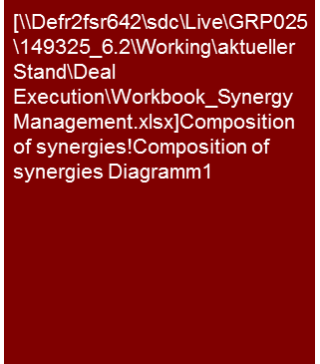
3. How are the synergy potentials assessed? (3/8) – Project example 1
Synergy Management
Core statements:
The sustainable synergy potential (“gross effect“) identified from A through the merger of A and B is about € 13m p.a. It results mainly from the materials and personnel cost
Functions needed in the future, which are required due to the release from the E-group, reduce the synergy potential
The management of A currently expects a delay in the realization of the synergy potentials
Composition of the operating synergies
Planning of the operating synergies in the mid-term plan 2012 (continued)
The complete realization of the identified synergy potentials of about €13 million p.a. before adverse effects (“gross effect“) is expected in the mid-term plan 2012 at the end of the detail planning period. At the end of 2012, ca. €5.3 million, (about 41 % of the synergy potential) shall be realized.
The catalogue of measures included in the mid-term plan 2012 mainly focuses cost savings. In particular:
Integration of the individual IT systems of A and B;
Merger of site administrations;
Personnel cuts in the operating staff areas;
Merger of procurement and sales processes.
Synergies from the merger under company law
Additionally tax synergies resulting from the planned merger under company law have been identifies.
Current assessment of the management of A
According to the current expectations of A, a delay of the realization of the intended synergy potentials cannot be excluded. The current estimate is based on the delays in the merger under company law as well as a contemplated stretching with regard to the reduction of the headcount in view of the demographic development at A.
The amount of the expected sustainable synergy potentials is, however, still considered accurate. The value effects resulting from the delay are immaterial.
Source: Company information, KPMG analysis
Planning of the operating synergies in the mid-term plan 2012
Operating synergy effects are expected to start in 2012 by a joint management of the real estate holdings of A and B by the A GmbH: These will primarily impact costs of materials and personnel and are already considered in the mid-term plan 2012 in the individual expense items
Simultaneously, additional expenses (adverse effects) were considered for functions not needed in the past that were guaranteed by the inclusion in the E-group. The identified synergies were correspondingly reduced. The functions affect, amongst others, Finance, Tax and Auditing departments.

Slide 15
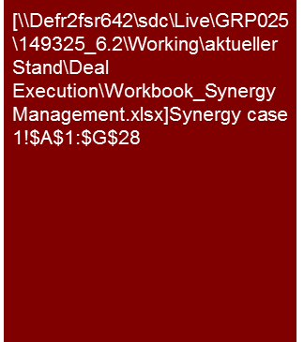
3. How are the synergy potentials assessed? (4/8) – Project example 2
Synergy Management
Core statements:
The expected synergies consist primarily of Opex and Capex savings
Sales synergies play a subordinate role
Illustrative example
Source: Company information, KPMG analysis

Slide 16
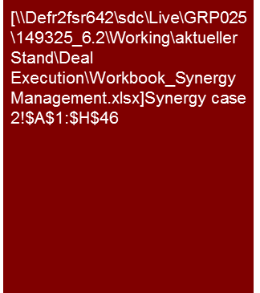
3. How are the synergy potentials assessed? (5/8) – Project example 2
Synergy Management
Core statements:
The Opex savings attain a value proposition of Opex €3.4 billion and Capex €1.4 billion.
Less the restructuring costs the total value proposition is €4.3 billion
Illustrative example
Source: Company information, KPMG analysis
Source: Company information, KPMG analysis

Slide 17
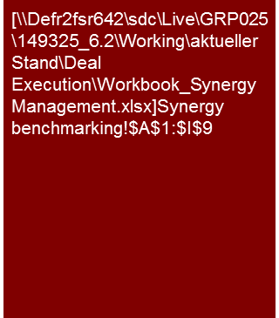
3. How are the synergy potentials assessed? (6/8) – Project example 2
Synergy Management
Core statements:
Benchmarking of the synergies with comparable transactions
The Opex synergies are on the upper end of a range of comparable transactions
By contrast the total value proposition is on the lower end of a range of comparable transactions
This is caused by higher Capex savings of comparators
Run-rate
Opex
savings
as % of
combined
revenues
Illustrative example
NPV total
synergies
as % of
combined
revenues
Source: Company information, KPMG analysis, Merger market, Capital IQ, own research
Project [Sample] – Synergy benchmarking against comparable transactions
6.0%
6.5%
7%
40%
50%
60%
70%
80%
90%
100%
110%
Bandwidth comparable transactions
Combined business <sample>
Source: KPMG analysis

Slide 18
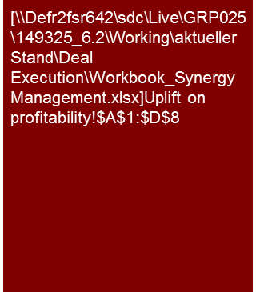
3. How are the synergy potentials assessed? (7/8) – Project example 2
Synergy Management
Core statements:
The consideration of synergies results in a significant increase of the EBITDA margin from 29.4% to 35.5 % and is within the range of comparable companies
The cash contribution margin is, as a result of the synergies, even higher than comparable companies
EBITDA
margin
Illustrative example
Cash
Contribution margin
Note: (a) information on combined revenues and EBITDA pre-synergies based on consensus estimates 2012 Capital IQ
Source: KPMG analysis
Project [Sample] - Pro-forma profitability benchmark with [to be specified] companies
10%
15%
20%
25%
30%
35%
40%
45%
Bandwidth wider peer group
Combined business ex synergies <sample>
Combined business with synergies <sample>
Most comparable
Source: KPMG analysis

Slide 19
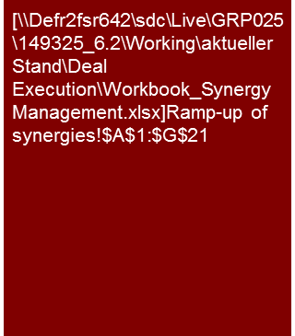
3. How are the synergy potentials assessed? (8/8) – Project example 2
Synergy Management
Core statements:
The complete synergy potentials are achieved partially as of year 4
The primary integration costs incur in year 1
Illustrative example
Source: Company information, KPMG analysis

Slide 20
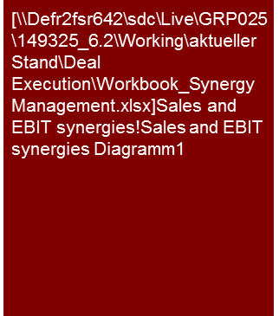
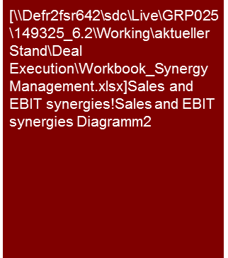
4. Synergy assessment and synergy case: What financial goals must be achieved overall? (project example)
Synergy Management
Core statements:
Ambitious timeline for synergies (sales and costs) in the next 5 years
Sales synergies impact both the target and the buyer side through the joint use of a sales network and the mutual sales of combined products
Revenue
Challenging market environment
Strong revenue growth with a projected CAGR of 19%
Growth drives EBIT with a CAGR of 102%
Challenging business case can only be met by focusing on the Top Line
Management attention required to ensure Stand Alone Growth and realization of Synergy Targets
CAGR: +19%
EBIT
CAGR +102%

Slide 21
5. Synergy Case: What additional costs (or optimization potential) occur with the implementation? (project example)
Synergy Management
Core statements:
It must always be checked which synergies can be realized with previous or additional costs
The effects on both company sides should be highlighted for each synergy
Guideline for workshops with Controlling/Finance staff of buyer/target or JV partner
Top-line analysis: Is the assumed growth in volume realistic? Are the assumed prices competitive?
With the determination of the financial effects of the synergies, it should be analyzed, how the costs change during the planning period with varying amounts of products/projects (primarily production and R&D expenses)
Are there learning curve effects, economies of scale / scope?
Are there counteracting effects, e.g. dissynergies, capex etc.? Are there expenses for demos/demonstration devices, start-up of equipment required in the framework of individual synergies?
Where are the expenses for additional sales volume (front/back office)?
Are Capex, recurring repeating expenditures, one-offs required above and beyond the existing infrastructure?
Is the use of additional staff required?
Are there project or product-specific (and therefore to be standardized?) expenses?
Is there a customizing expense?
What is the realistic, project specific warranty risk (2% of sales?)
Can current structures be optimized and made more efficient?
In the development of new products:
Is there a replacement of existing products by new products (sales/EBIT effects)?
Are new products or existing products with leaner versions and less features required?
Definition of the cost/sales drivers: Are ratios or FTE drivers used for the model?

Slide 22
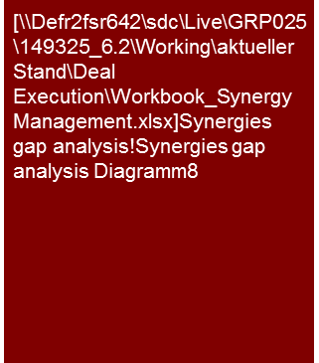
6. Synergy Case: Gap analysis - Can the goals be achieved according to the forecast? (project example)
Synergy Management
Core statements:
The analysis of the synergy potentials indicates significant deficits to the predetermined goals of the M&A business case
Revenue and Cost Synergies (EBIT effects p.a. in €m)
Total M&A:
45.4 m
Total Plan:
11.5 m
12.8
13.5
22.1 m
7.2 m
23.3 m
4.3 m
10.1
9.7 m
76 %
10.3 m
76 %
6.9
7.3 m
72 %
5.0 m
72 %
2.8
3.1
3.2
2.1
1.9
0.6
1.5 m
71%
0.1
0.4
M&A Target
Synergy Evaluation
M&A Target
Synergy Evaluation
M&A Target
Synergy Evaluation
M&A Target
Synergy Evaluation
M&A Target
Synergy Evaluation
2013
2014
2015
2016
2017
M&A Target
Evaluated sales and cost synergies deviate significantly from the synergy target across the entire projection period
Synergy gap of 71% (2013) increases in 2016 and 2017 to 76%, mainly due to significant shortfalls in sales synergies
The cumulative synergy gap amounts to €33.9 million from 2013 to 2017, a shortfall of 75% versus the synergy target

Slide 23
7. How can an effective monitoring be guaranteed? (1/5) – Project example reporting without TrAction
Synergy Management
Core statements:
Synergy A realizes quick wins in 2013
The measures already initiated are on track
The target achievement can be negatively influenced by risks A and B
Description/Owner
Indicative Benefits (EBIT, €m)
….
Implementation planning
Detailed measure | Start | End | Responsibility | Status
… | … | … | … | …
… | … | … | … | …
… | … | … | … | …
… | … | … | … | …
… | … | … | … | …
… | … | … | … | …
… | … | … | … | …
… | … | … | … | …
Assumptions
…
Potential risks and implementation complexity
…

Slide 24
7. How can an effective monitoring be guaranteed? (2/5) Metrics management with TrAction
Flag: TrAction is a global project management tool. For the distribution in your region please refer to following link: https://www.kpmgspectrum.com/content/Spectrum/en/Operating-Intelligence/TrAction.html
Synergy Management
Core statements:
A systematic approach supports the complete realization of effects
Module
Project organization
Definition of measures
Implementation controlling
Challenge
No impairment of daily business
Operationalization of savings targets
Assurance of complete target achievement
KPMG approach
Tailored project organization (“fit to purpose”)
Creation of clear responsibilities
Organizational involvement
Assurance of sufficient resources (internal and external)
Workshops for generation of ideas
Breakdown of the potentials in projects, measures and activities
Determination of milestones
Quantification of measures
Transition of the measures into planning
Software-supported monitoring of the implementation progress
Regular reporting
Early identification of deviations from plan
Definition of counter-measures
Preparation of the steering committee
TrAction Tool
→ Find presentation @ Title page
Results
Effectiveness
Schedule & effects
Transparency

Slide 25

7. How can an effective monitoring be guaranteed? (3/5) – Metrics management with TrAction
Flag: TrAction is a global project management tool. For the distribution in your region please refer to following link: https://www.kpmgspectrum.com/content/Spectrum/en/Operating-Intelligence/TrAction.html
Synergy Management
Core statements:
TrAction reduces complexity, generates transparency and allows a resource-saving project organization
Schematic structure of the measures area
Complexity
Projects
25.0
5
1.5
2.0
Package of measures
3.5
40
4.0
Package of measures 1
Package of measures 2
Package of measures 3
Measures
10.0
4.0
110
Activities
420
Actual EBIT 2012
Overhead
Costs of materials
OOE
Processes
Sales
Target EBIT 2016
TrAction Tool
→ Find presentation @ Title page
OOE = Other operating expenses

Slide 26
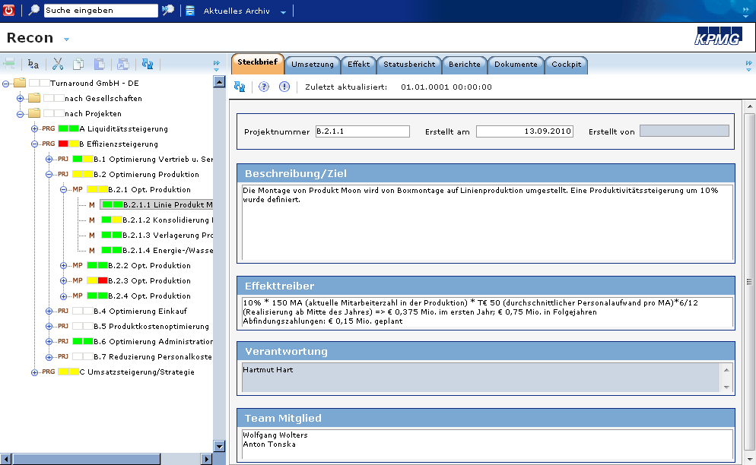
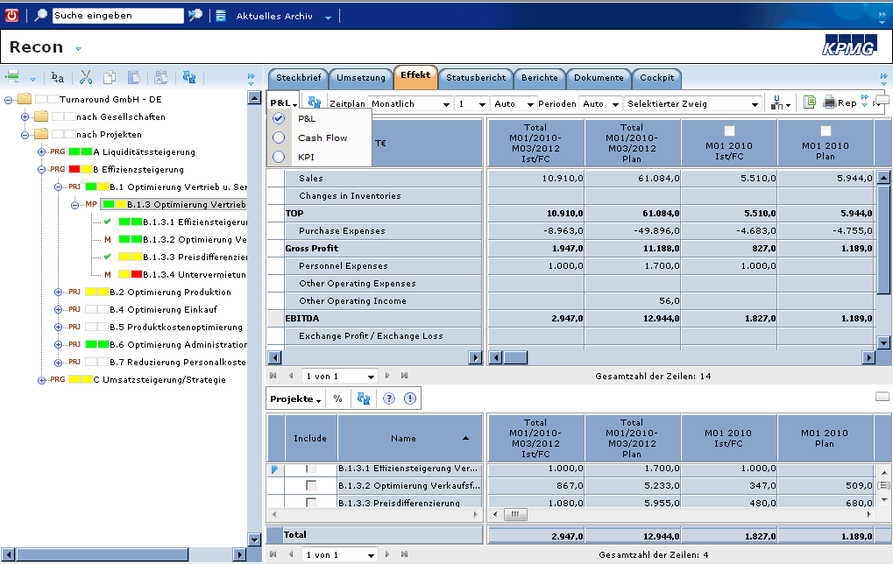
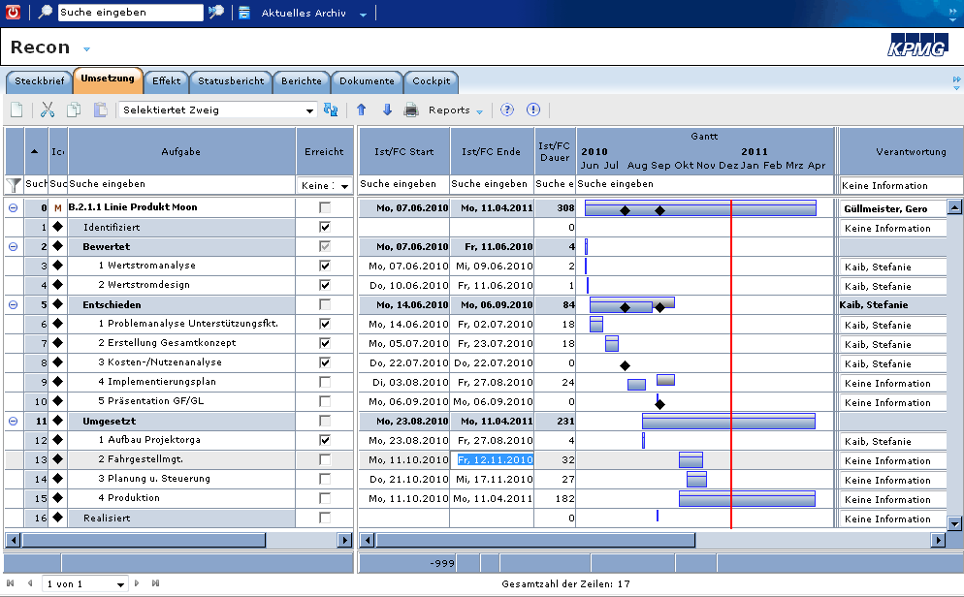
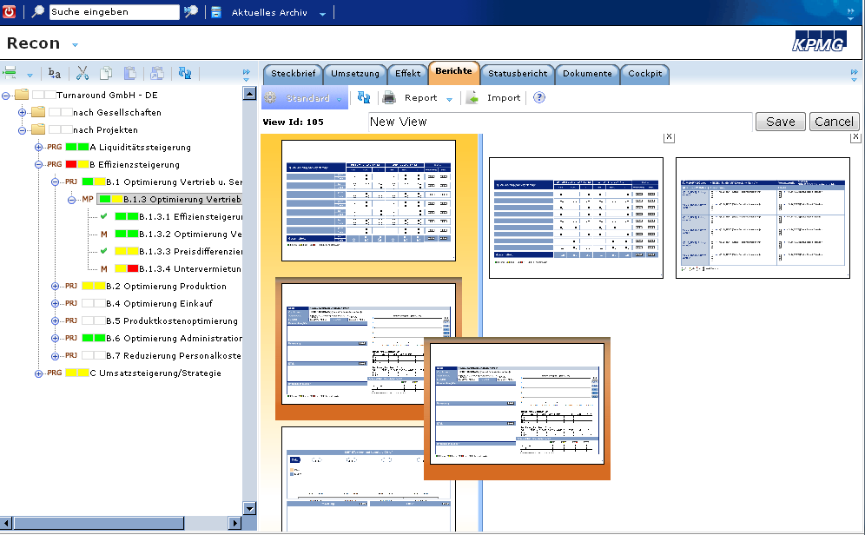
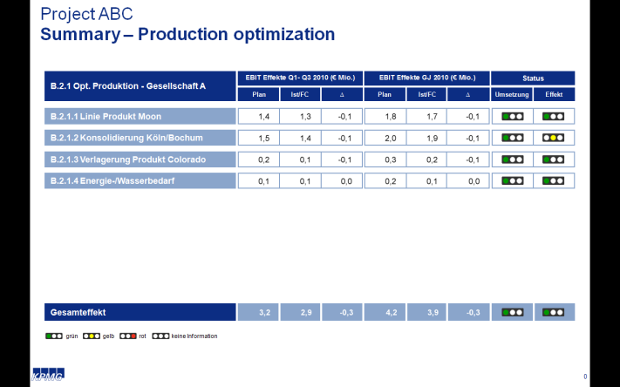
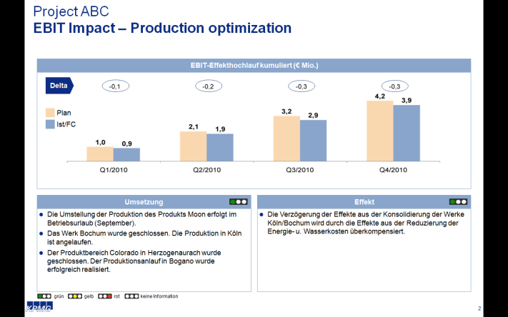
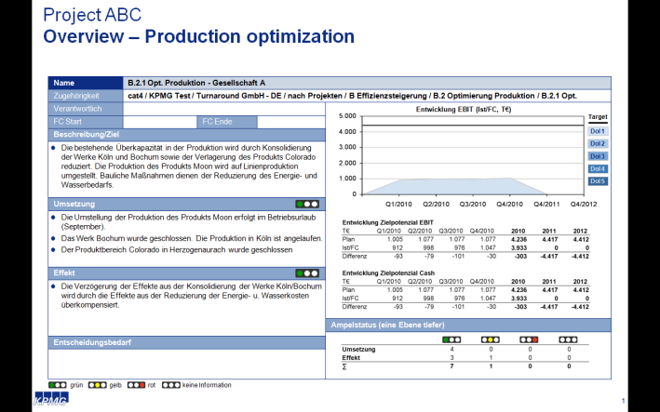
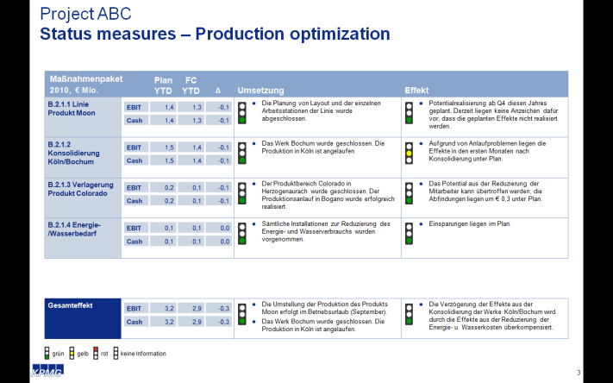
7. How can an effective monitoring be guaranteed? (4/5) Metrics management with TrAction
Flag: TrAction is a global project management tool. For the distribution in your region please refer to following link: https://www.kpmgspectrum.com/content/Spectrum/en/Operating-Intelligence/TrAction.html
Synergy Management
Core statements:
TrAction can be introduced quickly, is flexible and can be operated intuitively
Individual configuration
Web-based: Immediate access, no implementation expenses, central data storage
Individual configuration: Adjustment of the structure and access rights
Intuitive operation: Rapid user acceptance
Responsibilities: Clearly defined areas of responsibility and central register of activities
Responsibilities & Milestones
Illustrative example
Transparency: Defined milestones and quantified effects
Reports: Automatic reporting
Alerts: Automated reminders, statistics and evaluations
Document filing: Central access
Low licensing costs: Low operating costs
Quantified effects
Automated reports
Illustrative example
TrAction Tool
→ Find presentation @ Title page

Slide 27
7. How can an effective monitoring be guaranteed? (5/5) Metrics management with TrAction
Flag: TrAction is a global project management tool. For the distribution in your region please refer to following link: https://www.kpmgspectrum.com/content/Spectrum/en/Operating-Intelligence/TrAction.html
Synergy Management
Core statements:
Individualized TrAction reports are generated automatically
Illustrative example
Illustrative example
Illustrative example
Illustrative example
TrAction Tool
→ Find presentation @ Title page

Slide 28
© 2017 KPMG International Cooperative (“KPMG International”). KPMG International provides no client services and is a Swiss entity with which the independent member firms of the KPMG network are affiliated.

